Slide 1
JNCIS-ENT
Layer 2 switching and VLANs

Slide 2
EX Series Switches
5
EX Series Models and Features

Slide 3
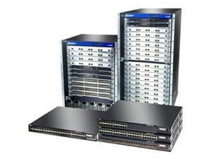
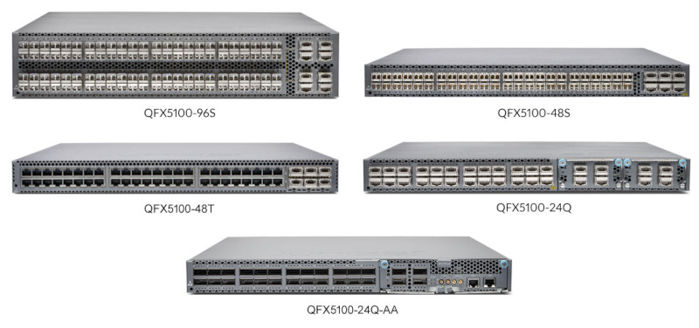
EX Series Switches
Enterprise switching platforms
Lower performance* platforms than QFX series
Split into 2 categories:
Fixed chassis EX switches
Modular chassis EX switches
EX Series Switches
QFX Series Switches

Slide 4
Fixed Chassis Switches
All of the EX series switch chassis below can provide Power over Ethernet (PoE)
Chassis | # Ports | Uplink | Virtual Chassis | Usage
EX2200* | 12-48 | 2-4 x SFP | Yes | Access-layer branch office and campus.
EX2300 | 12-24 | 2-4 x SFP/XFP/SFP+ | Yes | Access-layer branch office and campus.
EX3300 | 24-48 | 4 x SFP/XFP/SFP+ | Yes | Access-layer branch office and campus.
EX3400 | 24-48 | 2-4 x SFP/XFP/SFP+/QSFP+ | Yes | High-performance access-layer branch office and campus.
EX4200* | 24-48 | 2-4 x SFP/XFP/SFP+ | Yes | Data center, campus and branch office.
EX4300 | 12-48 | 4 x SFP/XFP/SFP+/QSFP+ | Yes | Data center, campus and branch office.
Notes:
*EX2200 and EX4200 series are EoL

Slide 5
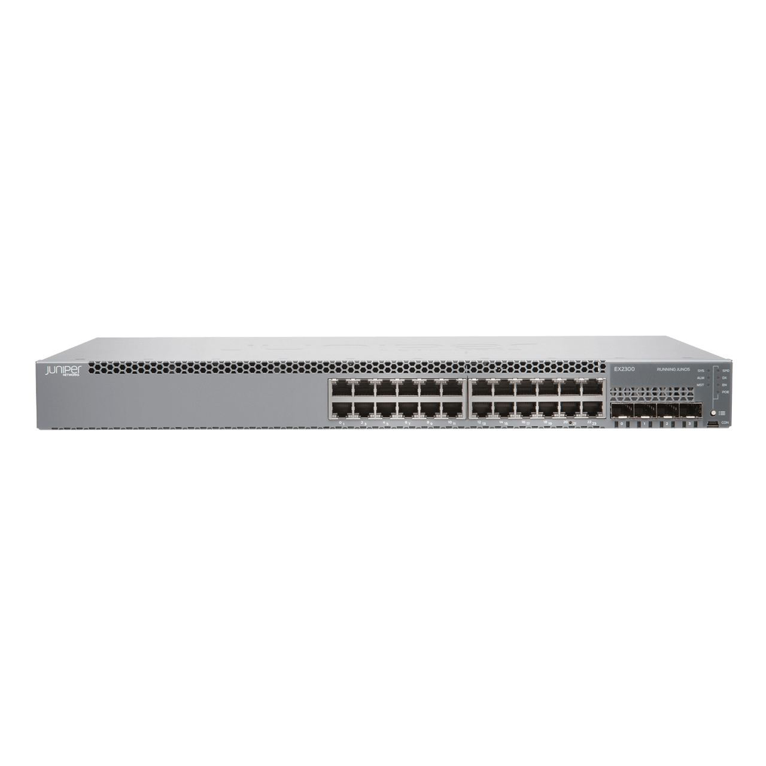
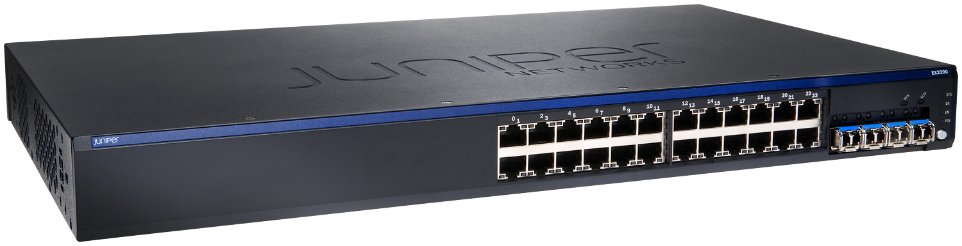
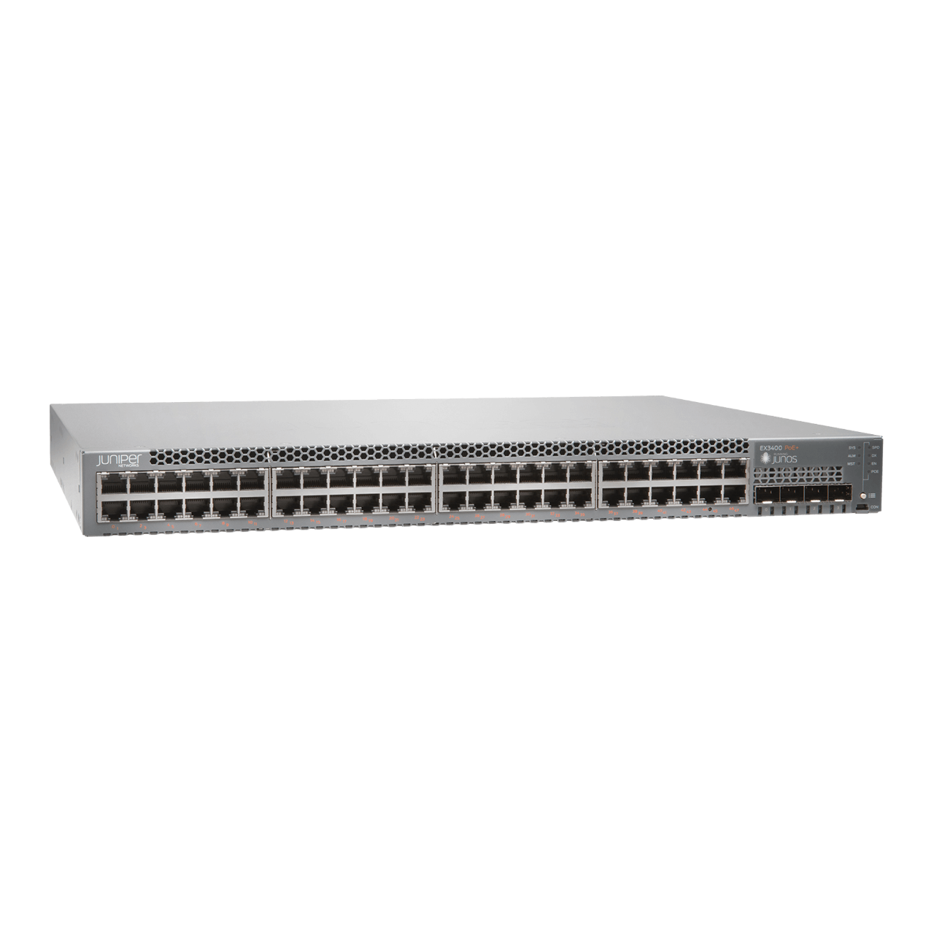
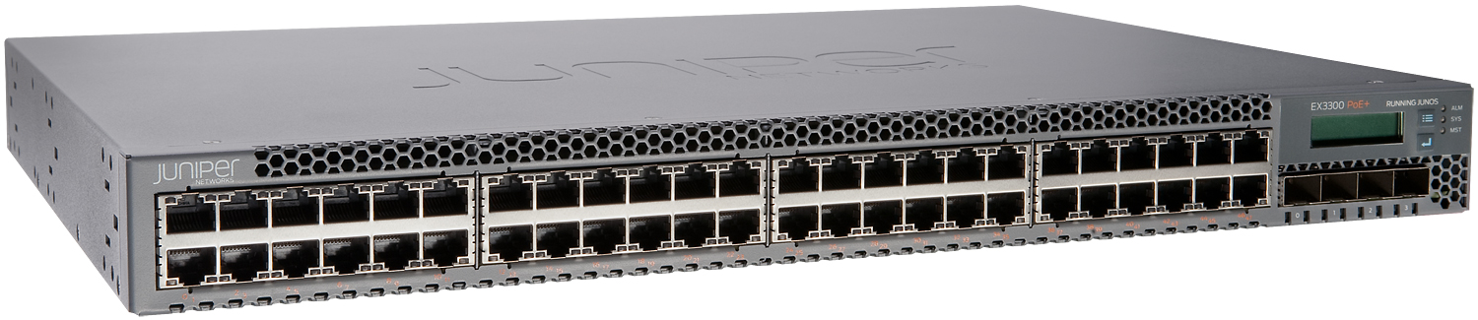
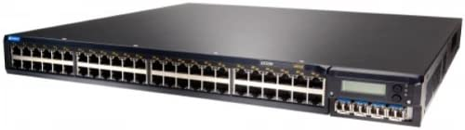
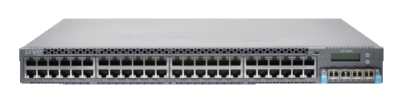
Fixed Chassis Switches
EX2200
EX2300
EX3300
EX3400
EX4200
EX4300

Slide 6
Modular Chassis Switches
Chassis | REs | PSUs | Line Card Slots
EX8208 | 2* | 6 | 8
EX8216 | 2* | 6 | 16
EX9204 | 2 | 4 | 2-3**
EX9208 | 2 | 4 | 6
EX9214 | 2 | 4 | 12
Notes:
*If using virtual-chassis (stacking) then an XRE (External Routing Engine) must be used for these models.
**3 line cards can be used if in single-RE configuration. 4 slots are available.

Slide 7
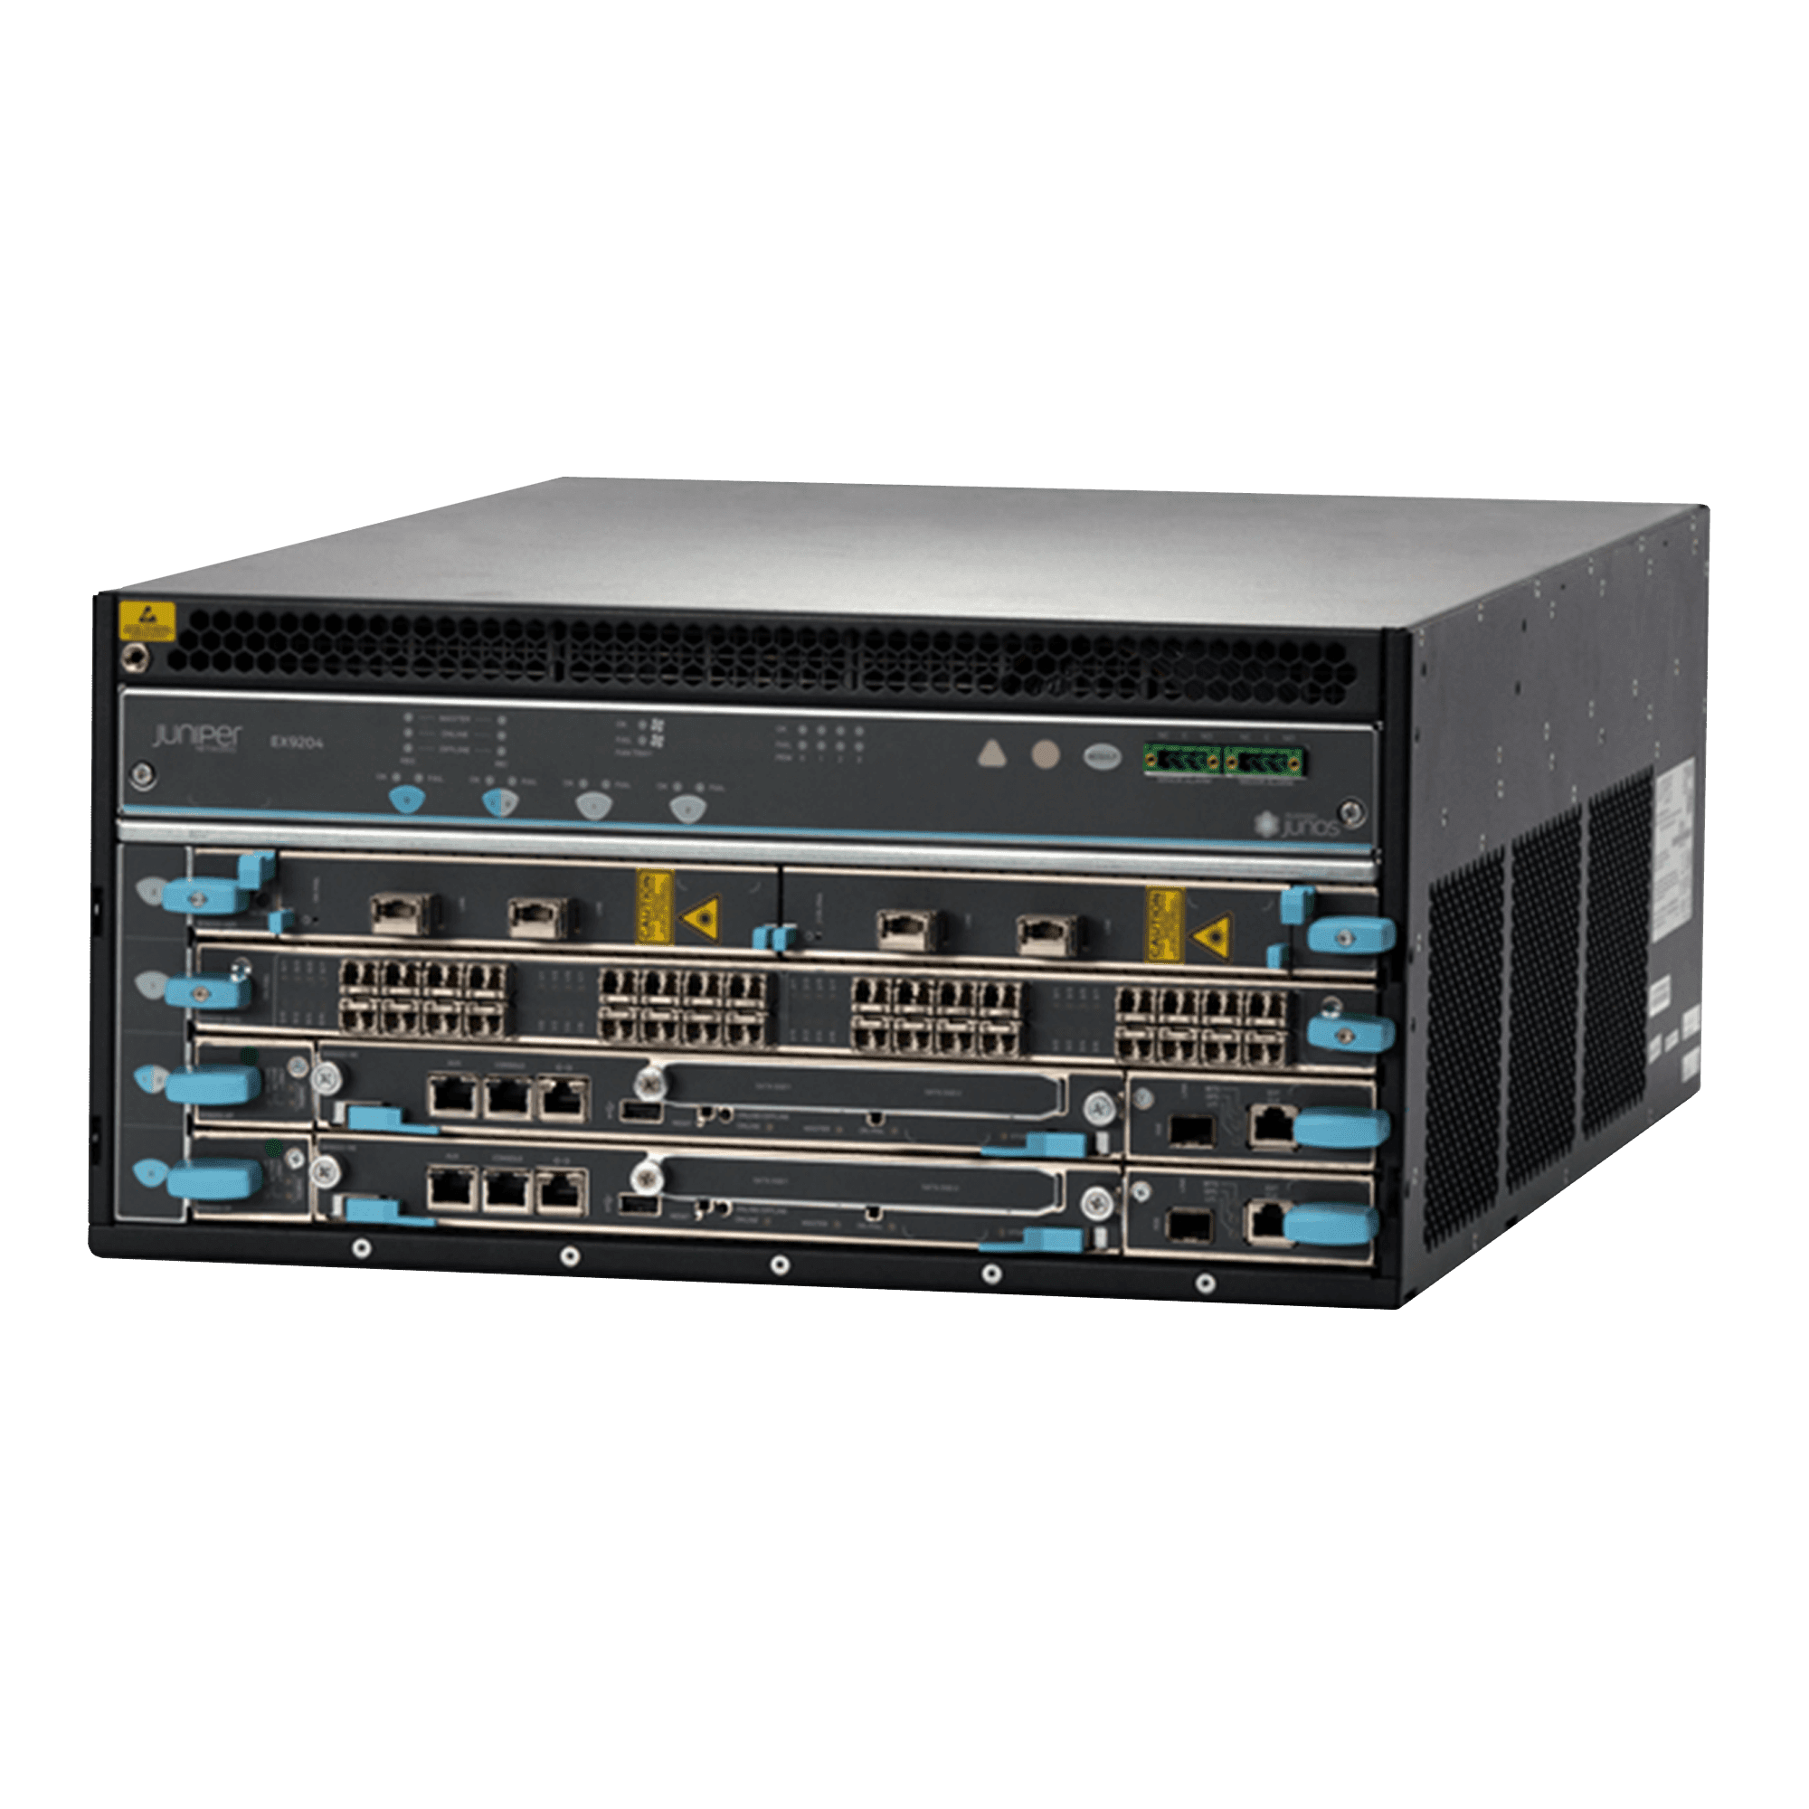
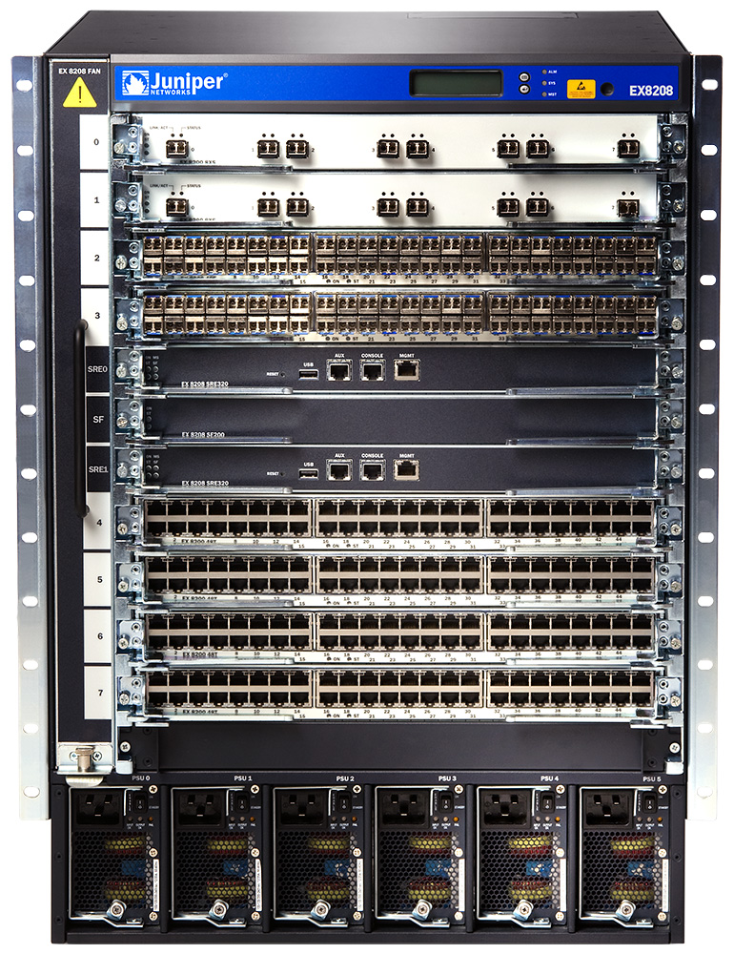
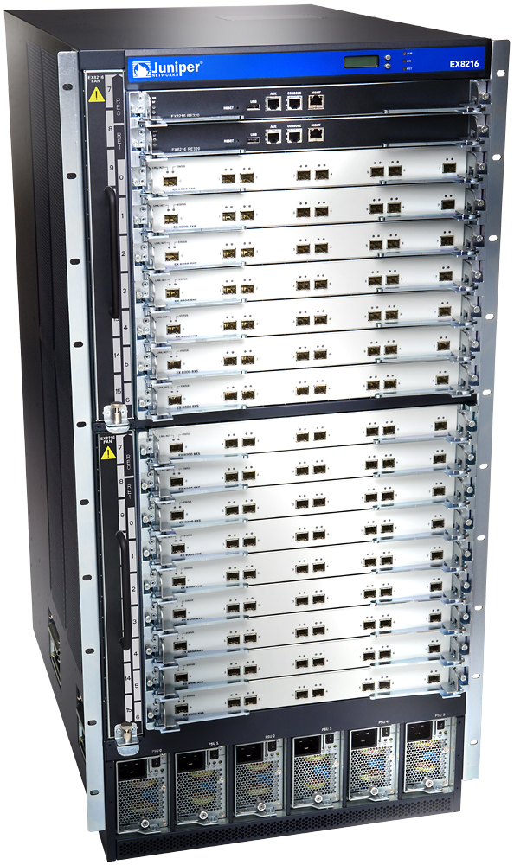
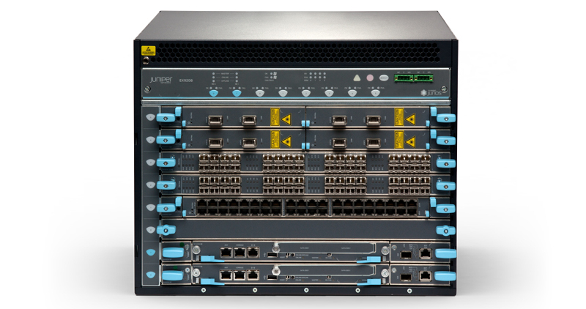
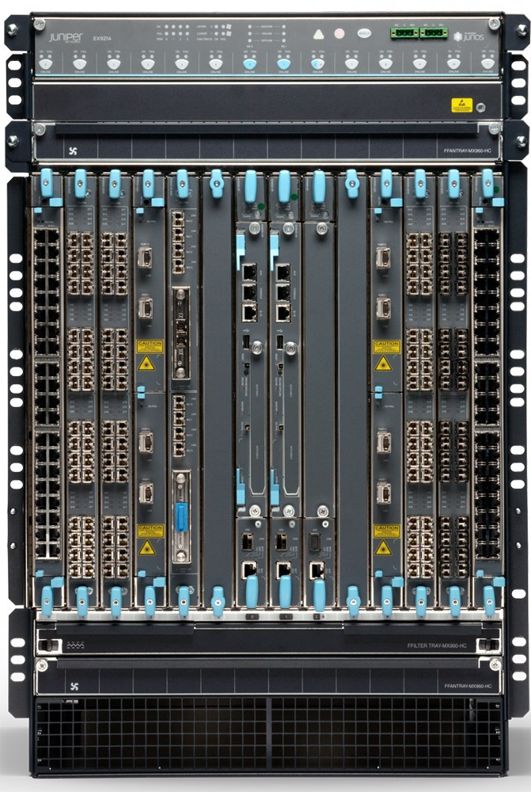
Modular Chassis Switches
EX9204
EX9208
EX8208
EX8216
EX9214

